Slide 1
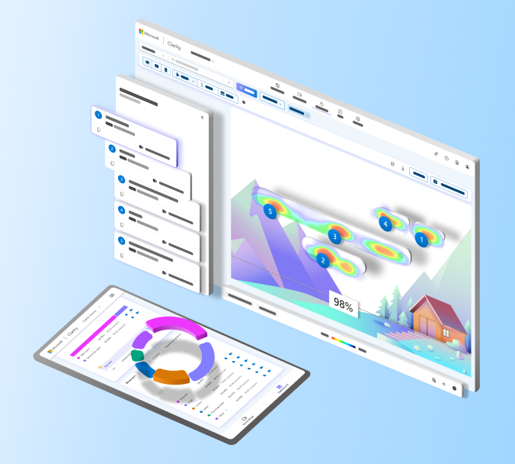
Microsoft Clarity

Slide 2
Introduction
Clarity is a user behavior analytics tool that helps owner to understand how users interact with his website
Features:-
Session Recordings- It allows owner to see how users navigate and interact with the website. These recordings can help to identify user behaviors, problems, and areas for improvement.
Heatmaps: The service generates heatmaps that visually represent where users are clicking on our website which area of website users are visiting more or scrolling more . This can be valuable in understanding which areas of pages are getting the most attention.
ML Insights Dashboard: Clarity offers an insights dashboard that provides a summary of key metrics such as User overview, Insights, Watchlist, Events, Browser etc and trends related to user engagement on website.
Insights contains features like:-
Rage click
Dead clicks
Excessive Scrolling
Quick Backs
User Feedback: Clarity also provides a feature for users to leave feedback directly on your website.

Slide 3
How it captures User Interaction?
Microsoft Clarity captures user interaction on web pages through the use of tracking scripts that you embed on your website.
To use Microsoft Clarity, we need to integrate a specific tracking script into the HTML code of your website. This script is provided by Clarity when we set up our account.
Once the tracking script is added to our web pages, it collects data about user interactions in real-time as visitors navigate through our site. The script captures information such as clicks, mouse movements, scrolls, and other interactions.
Heatmaps and Dashboard take time to load in starting for showing the result because it take time to analyze.

Slide 4
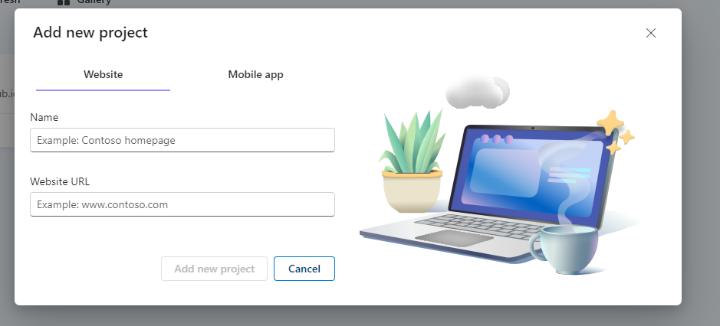
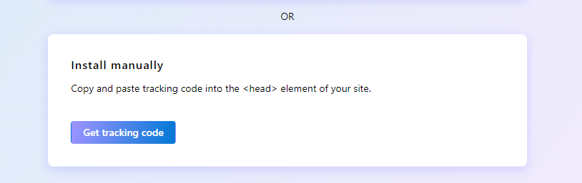
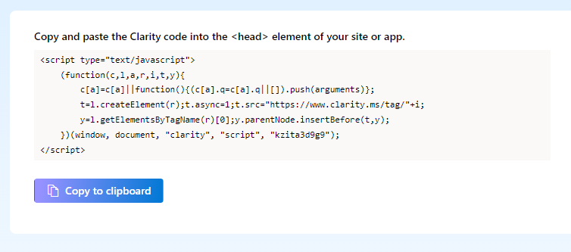
How to setup?
Enter the name and provide the website URL
Choose Install manually
Copy and paste the clarity code in the HTML head tag

Slide 5
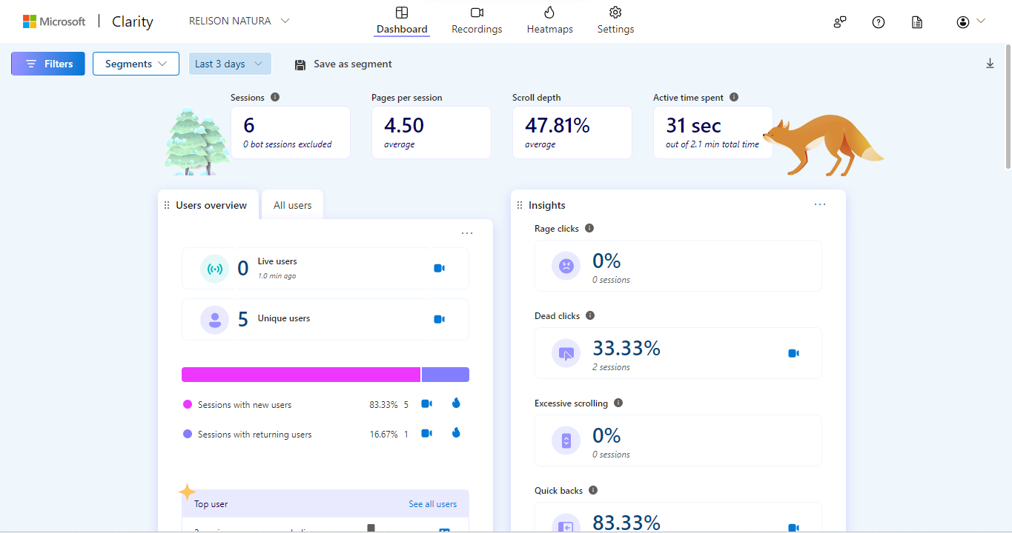
After Setting UP
Dashboard

Slide 6
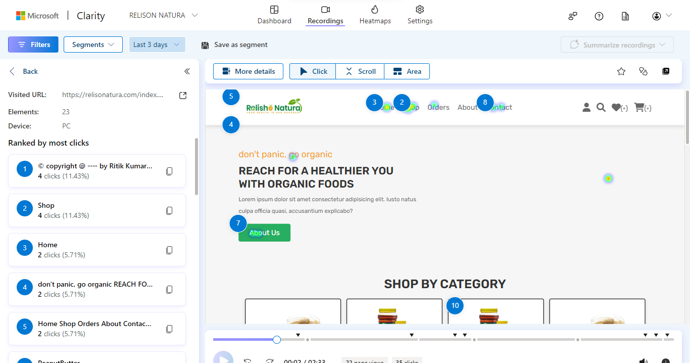
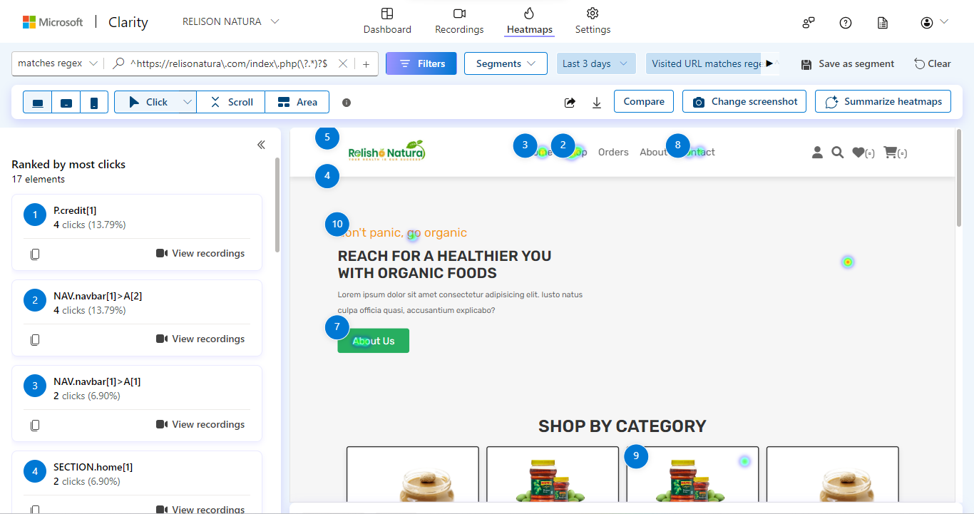
Recordings
Heatmaps

Slide 7
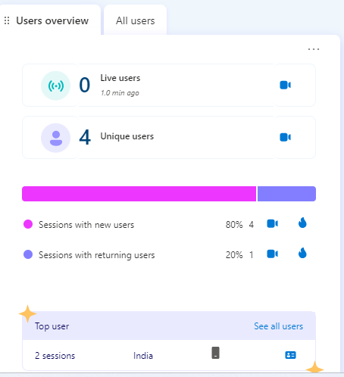
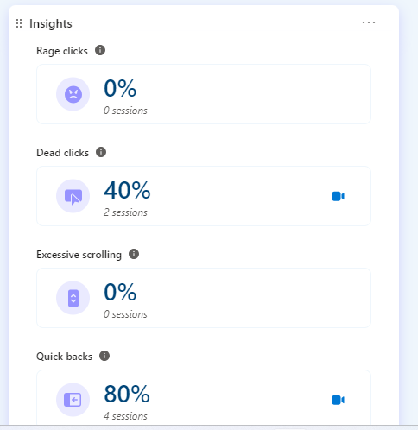
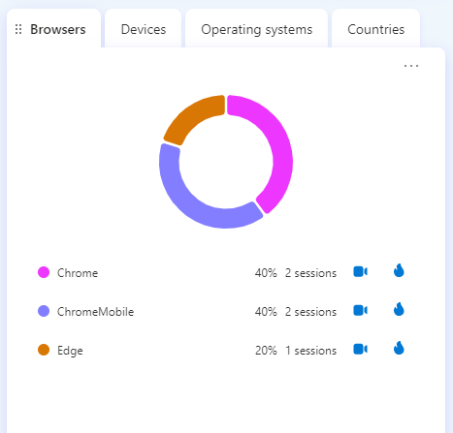
Data Analyzation
I use this RelisoNatura | Home page site for analyzing data :-
Here are the
User overview:-
4 Unique user
Insights:-
Rage clicks-0%
Dead clicks-40%
Excessive Scrolling-0%
Quick backs-80%
Browsers Use:-
Chrome
Chrome Mobile
Edge

Slide 8
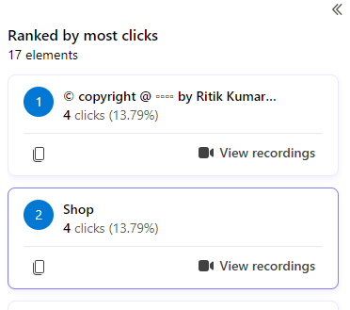
Features and button Receive the Most Click
The most clicked features buttons are:-
Link of profile given in footer
Shop button present in navigation bar

Slide 9
Final Report
User Behavior Insights:
Rage Clicks: No instances of users repeatedly clicking in frustration.
Dead Clicks: 40% of clicks didn't result in any action. This could indicate areas of confusion or non-responsive elements.
Excessive Scrolling: No observed excessive scrolling behavior.
Quick Backs: 80% of users navigated back quickly after viewing a page. This may suggest content or usability issues.
Browsers in Use:
Chrome
Chrome Mobile
Edge
Performance Overview:
Overall performance score: 99/100, indicating excellent website performance.
Largest Contentful Paint (LCP): 2.1 seconds, representing the time taken to load the main content. Aim for further improvement if necessary.
First Input Delay (FID): 2 milliseconds, indicating a quick response to user interactions.
Cumulative Layout Shift (CLS): 0.005 seconds, showcasing minimal unexpected layout shifts during page loading.

Slide 10
Optimization we Can do:-
Dead Clicks Analysis:
Investigate the areas where dead clicks occurred. Optimize elements to ensure they are responsive and functional.
Quick Backs Understanding:
Analyze the content or pages that resulted in quick backs. Identify potential issues and enhance user engagement.
LCP Improvement:
Although LCP is good, consider optimizing further for a faster loading experience, especially for users with slower internet connections.

Slide 11
Thank you!!!

